Slide 1
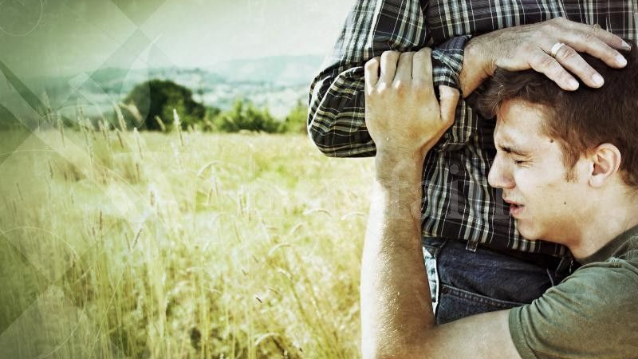
The Prodigal Son
“A Father & two sons”

Slide 2
Today’s reading
Luke 15:11-32

Slide 3
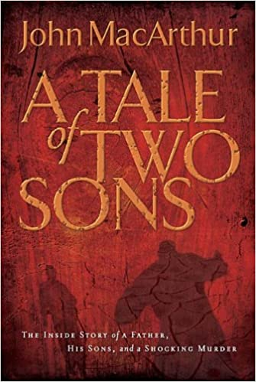
Book Recommendation

Slide 4
What is a parable?
Something placed alongside something else for the purpose of pointing out the likeness or making an important association between two things
A simple metaphor or simile in story form

Slide 5
How do you interpret parables?
Don’t assume the stories are historical
Don’t propose allegorical meanings that aren’t anchored in the text
Determine the main point or points
Pay attention to the parable’s historical and literary context
Recognize common symbols
Translate the main point into your own context

Slide 6
Central Theme
“Jesus is pointing out the stark contrast between god’s own delight in the redemption of sinners and the pharisees’ inflexible hostility toward those same sinners”
We should rejoice when God graciously saves sinners

Slide 7
The Audience
A mix of corrupt tax collectors and sinners who were eager to hear Jesus’ good news
A group of hyper religious pharisees and scribes who were angry w/ Jesus.
In Luke 15:1-2 they just grumbled that he ”receives sinners and eats with them.”

Slide 8
Comparing the 3 Parables
Literary Context: These parables go together
The first two Parables: Show heaven’s great joy over sinner’s who repent
The lost Sheep: Shows the shepherd doing all the work
The lost coin: Shows the relentless pursuit of the seeker
The third parable shows heaven’s joy too, but sets it against the background of the elder brother’s hellish displeasure over his brother’s return and his father’s delight
Looks at conversion from the sinner's perspective

Slide 9
The prodigal son
Meet the Characters

Slide 10
Prodigal
Old English word that speaks of reckless wastefulness or lavish estravagance
“UNDISCIPLINED YOUNG PERSON WHO WASTES THE BEST PART OF HIS LIFE THROUGH EXTRAVAGANT SELF-INDULGENCE AND BECOMES A SLAVE TO HIS OWN LUST AND SIN.”

Slide 11
“Father give me my share of the estate…”

Slide 12
THE REQUEST

Slide 13
DISREGARD FOR HIS INHERITANCE
Family lands and possessions were not to be sold or transferred outside the family line.
It was a son’s duty to keep the family legacy alive
The first born was given more to create a stable financial foundation for the family
The prodigal showed no gratitude in his heart for his family’s legacy
Lacked patience and discipline

Slide 14
DISHONOR FOR HIS FATHER
He was saying to his Father…
“Dad, I wish you were dead.”
“You are a barrier.”
”I want out of this family now!”

Slide 15
Demand for His Birthright
Translated “my share of the family’s belongings”
Demanding that the possessions be distributed early
The law of Primogeniture stated, “1/3 of all the family assets would go to the younger son WHEN THE FATHER DIED”
It was an unreasonable request
He wanted whatever he could get his hands on
Financially this was not a good decision for him

Slide 16
The Father
Meet the Characters

Slide 17
THE REsponse

Slide 18
Society’s Expectations
Publicly disgrace the son
Slap across the face
Formal dismissal from the family
Funeral

Slide 19
The Father’s Response
“The Pharisees would no doubt regard the father as even more shameful than the son at this point because in giving up his livelihood, he was in effect handing over the family honor and giving the boy license to trample on it.”
Granted his son what he asked for
Viewed as weak and pathetic
Shared in the shame of his son

Slide 20
Devotion for his Son
Loving father
Willing to endure humiliation so he wouldn’t have to disown his son
Suffered the greatest personal agony: grief of love rejected

Slide 21
“Not long after that, the younger son got together all that he had, set off for a distant country and there squandered his wealth in wild living”

Slide 22
Departs out into the world
Being pulled progressively downward by sin

Slide 23
“Gathered all Together”
Definition: Liquidated whatever he could, turning his inheritance into ready cash

Slide 24
“Journeyed to a far Country”
Gentile country = leaving his cultural heritage & his faith

Slide 25
The Pharisee’s view of the story
The prodigal son was definitely the villain
Everything in a Gentile culture was unclean. This boy was now completely defiled

Slide 26
”And there squandered his wealth in wild living”
Greek word is “diaskorpizo” = Throwing grain in the air and letting the wind blow the chaff away; to scatter abroad

Slide 27
HE got everything he wanted…for a brief moment in time…
The life of the party
Rich
”Friends” were plentiful

Slide 28
“After he had spent everything, there was a severe famine in that whole country, and he began to be in need”

Slide 29
Famines were serious
Families would be forced to sell all they had
Eat bark, roots, grass, white clay
Cannibalism was not out of the question

Slide 30
The Party was over
Faced a level desperation we cannot conceive
He was at the lowest part of his life
He was facing the consequences of his actions

Slide 31
“He went and joined himself to a citizen of that country, and he sent him into his fields to feed swine”

Slide 32
Joining himself to a citizen
Trying to avoid repentance
“Citizen” meant a privileged person
“Joined himself” = ”Kollao” in Greek
Literally means to “Glue”
The prodigal refused to leave him
He became a beggar
The citizen didn’t have an ounce of compassion for the prodigal

Slide 33
Feeding the pigs
Lowest possible chore in the whole hierarchy of labor
Completely immoral job from the Pharisee’s point of view
The location of the pigs would have been in a remote, harsh, rocky, wilderness
This is where the prodigal took up permanent residence

Slide 34
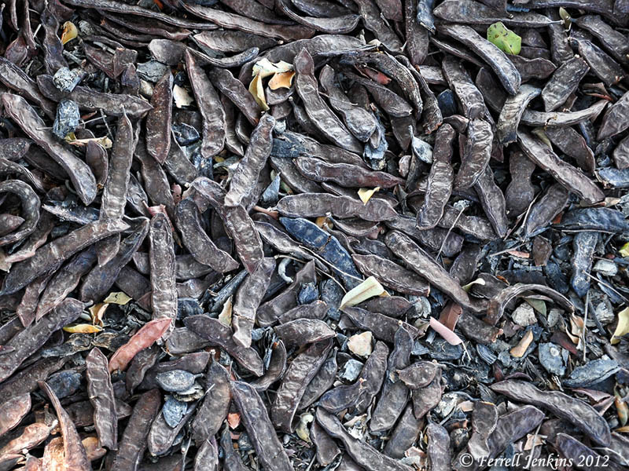
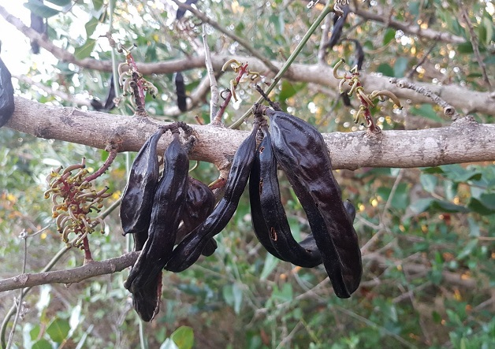
“He would gladly have filled his stomach with the pods that the swine ate…”
He was jealous of the pigs!
”Pods” = keration
Word means carob pods
Long string-bean shaped seed pods that grew on scrubby, treelike bushes
During a famine, these pods would have still grown
Inedible by humans
He would have eaten them if he could

Slide 35
Back to the pharisee’s view….
The prodigal was irredeemable at this point
“The typical reader cannot even begin to understand how loathsome the prodigal would seem to the Scribes and Pharisees”

