Slide 1
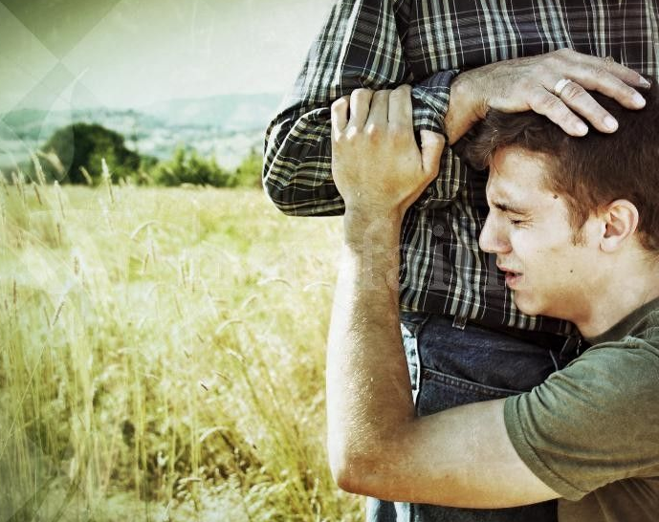
The Prodigal Son
Part 2

Slide 2
“He came to himself…”
Translation: He came to an end of himself
He came to his senses
He went from insanity to sanity
He finally reached repentance
Heartful, genuine repentance
Looking at life in a whole new way

Slide 3
“And he arose and came to his father..”
He was ready to face responsibility for his sin
Nothing was worse than the situation he was in
His view his father has changed
He saw him as generous and kind
“How many of my father’s hired servants have bread enough to spare..”
”Hired servant” was lower than a slave

Slide 4
“I perish with hunger…"
He was starving to death
For the first time, his focus was on what he NEEDED, not what he DESIRED
True repentance always starts with an accurate assessment of one’s own condition
His self-will was broken
A sinner goes from hiding from God to seeking him for salvation

Slide 5
“The man who has not repented, but who is only experiencing remorse, when he realizes he has done something against God, avoids God….But the extraordinary thing about the man who is convicted of sin by the Holy Spirit is that though he knows he has sinned against God, it is God he WANTS. He wants to be with God – that is peculiar paradox of repentance, wanting the one I have offended!”
-D. Martyn Lloyd-Jones

Slide 6
Going Home…
Going home was far different than leaving home
No resources
No energy
Heart was broken
Friendless
He was determined to get back to his father

Slide 7
Pharisee’s Check Point
They would expect the father to drop the hammer
At minimum, this boy was going to work hard the rest of his life and pay for what he did
The boy’s actions finally would have made some sense to them
It was time for him to get what he deserved!

Slide 8
The Return

Slide 9
Society’s Expectations
Father shouldn’t meet him face to face
Put the boy in the public square and have the entire village:
Mock him
Spit on him
Verbally abuse him
Fully penalty under the law of Moses was death by public stoning

Slide 10
The Father’s Response
Not only was he willing to grant mercy, but he was eager to forgive and lavish with grace
He was diligently looking for his son’s return
Saw him from a far off
What a picture of Christ!
Slow to anger and swift to forgive

Slide 11
The Father’s Response
He ran!
Noblemen never ran
Translation: Sprinting as if he were in an athletic competition
Arabic versions of the Bible avoided the true translation
They wanted to avoid the humiliating truth of this text that the father ran
1860 was the first time it was translated as “ran”

Slide 12
Pharisee’s Check Point
We see this scene as a tender moment
They saw it as:
Scandalous
Shocking
More offensive than the sins of the Prodigal

Slide 13
Unfinished Confession…
The prodigal never got to finish his full confession
The boy had done nothing whatsoever to atone for his sins
The father fully forgave him and held nothing back
The Pharisees would have noticed this detail

Slide 14
Lavished with Grace
Kissed him
Translation: Kissed him repeatedly
The boy was prepared to kiss the father’s feet and instead the father kisses him
Fully reinstated as his son

Slide 15
The Father’s Generosity
Gave his son the best he had to offer:
Sandals
Robe
Ring
The text reads he wanted these gifts given quickly
No one would believe this was an appropriate action to take

Slide 16
The Sandals
The Gift of Sonship
Only masters and their sons wore footwear
Showed the son’s immediate reinstatement as a privileged son

Slide 17
The Robe
The Gift of Honor
Every noblemen had a robe that was worn for very special occasions
Translated: First ranking garment
Signified a great honor

Slide 18
The Ring
The Gift of Authority
Signet ring that had the family crest or seal
Used for legal authentication
Symbol of authority in the family

Slide 19
The Celebration
The father was extremely wealthy
The fatted calf was killed
“Fatted” translates grain fed
This would produce the most succulent meat
Fed hundreds of people
Length of time: Possibly 3 days or more
“Heaven’s joy doesn’t end when a sinner comes home; that’s only the beginning.”
-John MacArthur

Slide 20
The Elder Son

Slide 21
Elder Brother’s Entrance
His absence till now says a lot…
Why didn’t he stop his younger brother?
Why did he go search for him?
He appears in the story and we read:
Resentful of the celebration
Critical of the Father’s Joy
Refuses to rejoice over his brother’s return

Slide 22
The Resentment
The world saw a devoted, hard working son
He was the “good son”
On the inside was rebellion
No relationship with his father
Didn’t love him
Didn’t care about his values
No relationship with his brother

Slide 23
No Invitation to the Party
Surprising that no one told the elder brother of his brother’s return
This event should have fallen on the elder brother’s shoulders
Further evidence that the elder son and the father had no relationship

Slide 24
The Servant Boy’s Reply
“Your brother has come, and because he has received him safe and sound, your father has killed the fatted calf.”
“Safe and sound” translated: wholeness, cleansing and health
The prodigal was not only home, but dramatically changed for the better

Slide 25
The Elder’s Son’s Reaction
His anger was directed at the Father
The father was spending resources that were supposed to be his
All he cared about were possessions
He was self-seeking

Slide 26
Pharisee’s Check Point
They finally felt like someone acted the way they should have
He should be outraged!
Finally someone steps up and says what needed to be said!

Slide 27
True Character Revealed
Angered over the celebration
The only person in 3 parables to refuse the invitation to celebrate
The son didn’t deserve the celebration
The Pharisees believed the sinners don’t deserve forgiveness and eternal life (They were right)
Their error was believing that they did deserve God’s favor

Slide 28
The Father’s Reaction
He loved both his sons
Pleaded with him to come join the celebration
He reached out to the elder son the same way he reached out to the prodigal son

Slide 29
The Elder Son’s Reaction
“Look! For so many years I have been serving you..”
The first word shows his attitude
The prodigal said, “Father”
The elder son said, “Look”
Serve is translated slave
Everything he did was under compulsion, not willfully
Implies the Father should seek forgiveness from him

Slide 30
“Son you are always with me”
Eight times the word “huios” is used meaning “Son”
This time the word “tekon” is used which means “my child”
He was still making an incredible plea to his eldest son

Slide 31
“It was right that we should make merry and be glad”
They HAD to celebrate
There was no other choice or alternative
It would have been wrong not to celebrate

Slide 32
The Tragic Ending
The parables has no ending
Jesus deliberately left us hanging
The Pharisees were going to determine how this story would end
Their choice? They killed Jesus!
“The elder son was outraged at his father. He picked up a piece of limber and beat him to death in front of everyone.”

Slide 33
One Last Time..
The didn’t say a word
They understood how the elder brother felt
They would have liked to have seen the father repent and agree with the elder son’s viewpoint
Publicly shame the prodigal

Slide 34
Final Thoughts
Thank God the Father showed:
Mercy
Forgiveness
Grace
Jesus endured shame that belonged to us
Praise God!

